Slide 1








ROS2 & ROS2 Navigation
ROS2 File System
Mar-12 2023
https://github.com/duyongquan/ros2_tutorials
AibotBeginer ROS2
quandy2020@126.com

Slide 2

2
Outline
ROS2发展史
ROS2产品应用
ROS2 File System
ROS2 Node
ROS2 发布者 & 订阅者
ROS2 Action & Service & Parameters
ROS2 CLI tools & Rqt tools
ROS2 Tutorials Architecture
Summary

Slide 3
3
ROS2发展史

Slide 4
















4
ROS2发展史
ROS1
May 2015
May 2016
May 2017
May 2018
March 2010
August 2010
March 2011
August 2012
April 2012
December 2012
September 2013
July 2014
ROS2
December 2017
July 2018
December 2018
May 2019
June 2019
May 2020
May 2021
May 2022

Slide 5
5
ROS2产品应用

Slide 6

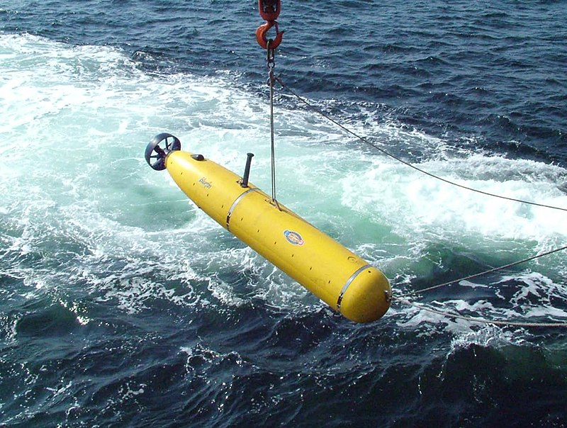
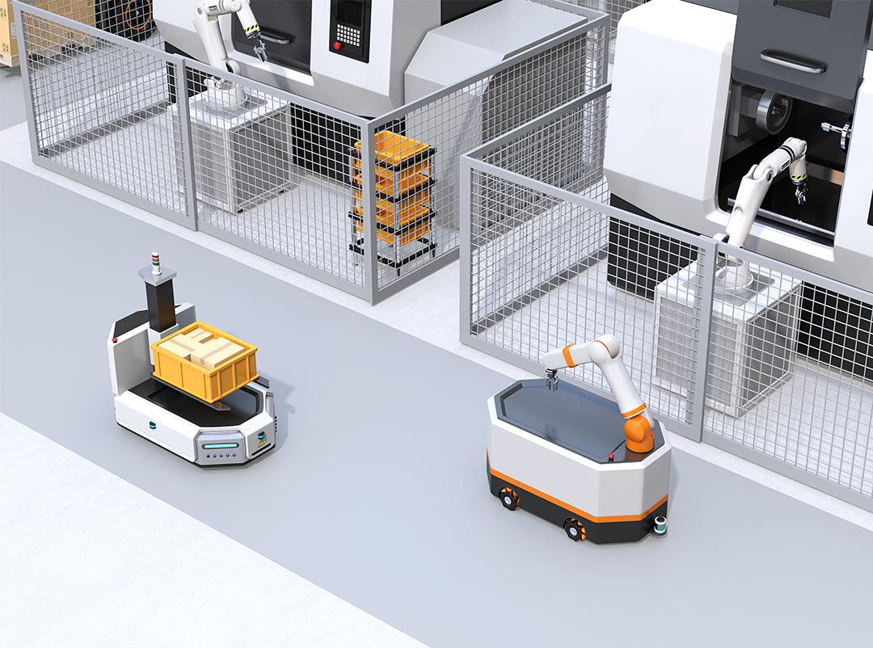
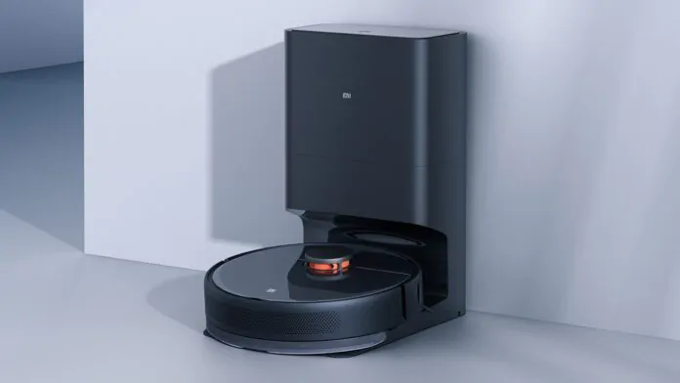

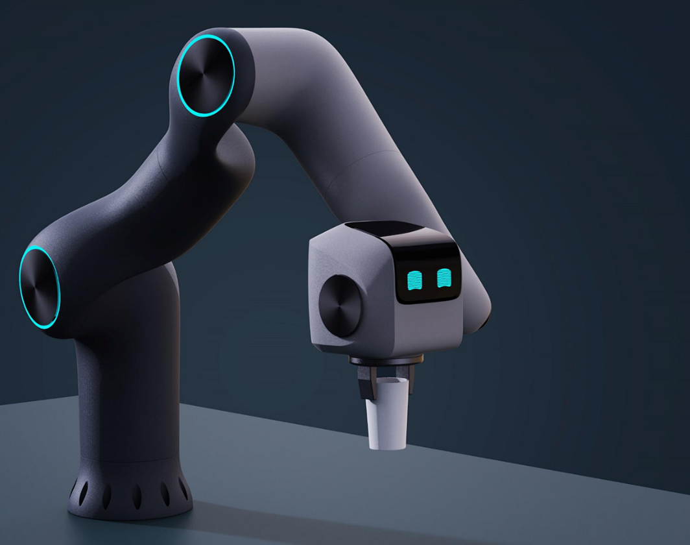


6
ROS2产品应用
百度 Apollo
潜水艇
AMR & AGV
Clearning Robot
港口巡检
机械臂
无人机
四足机器人

Slide 7
7
Why choice ROS2 ?
What is ROS2?
A framework to help you create a distributed application
Tools to help you develop your robot faster: logging, 3D visualization, graphs, plotting
3rd party plugins containing complete functionalities
An online community focused on open source robotics projects
Why should you learn ROS2?
ROS2 will speed up development projects, prototyping and testing phases
ROS2 will help you get a foot into the robotics world.
Prerequisites to learn ROS2?
The main 2 languages for ROS2 are Python and Cpp
How to use a terminal and command line tools. Such as Ubuntu.

Slide 8
8
ROS2 File System

Slide 9
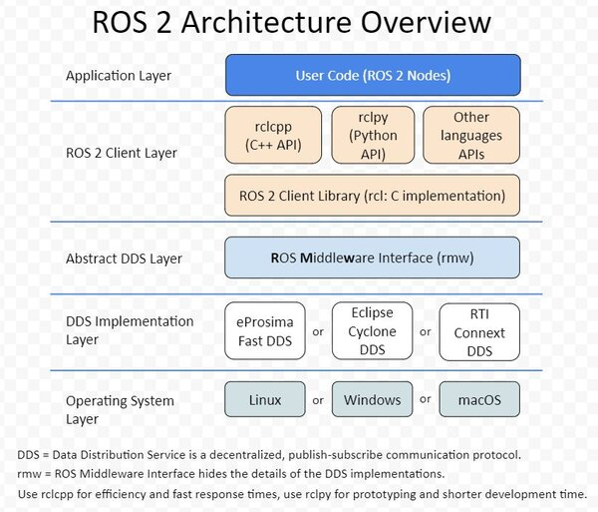
9
ROS2 File System
CLI tools & Client libraries
ROS2 Node
ROS2 Publisher
ROS2 Subscriber
ROS2 Service
ROS2 Action
ROS2 Parameter
ROS2 CLI tools & Rqt tools
ROS2 RVIZ & Gazebo

Slide 10
10
ROS2 Node

Slide 11
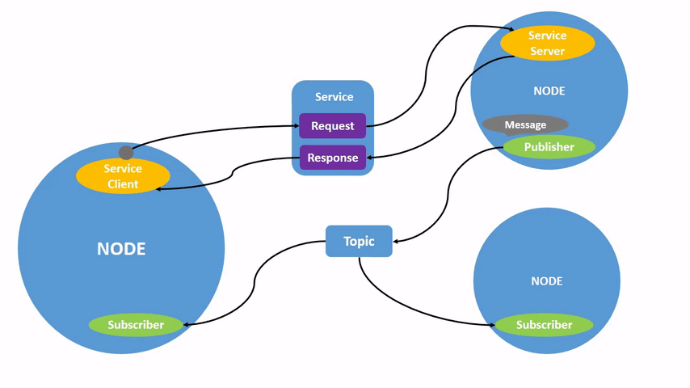
11
ROS2 Node
Each node in ROS should be responsible for a single
Each node can send and receive data to other nodes via topics,
services, actions, or parameters

Slide 12
12
ROS2 发布者 & 订阅者

Slide 13
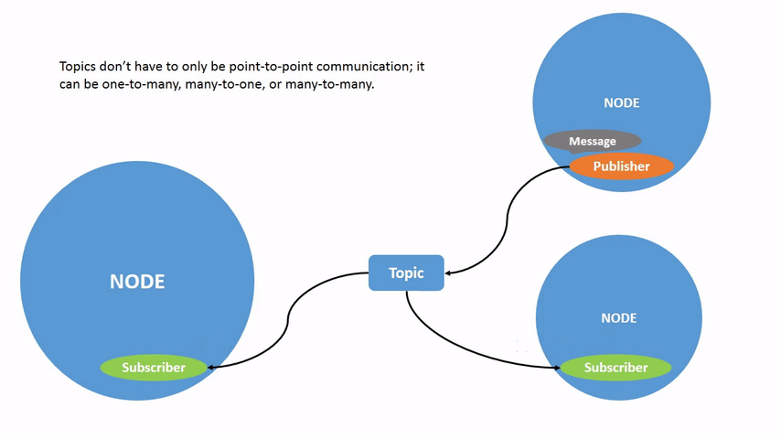
13
ROS2 发布者 & 订阅者

Slide 14
14
ROS2 Action & Service & Parameters

Slide 15
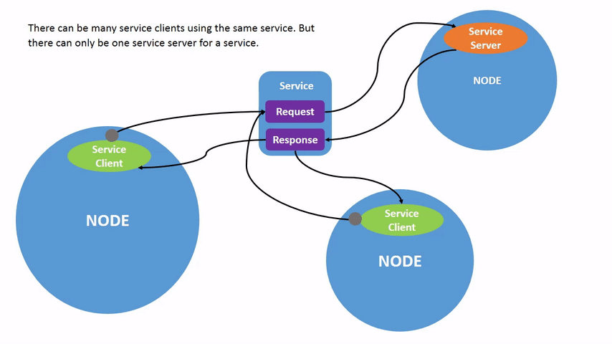
15
ROS2 Service

Slide 16
16
ROS2 Parameters
A parameter is a configuration value of a node
A node can store parameters as integers, floats, booleans, strings, and lists
Launch file configuration
Cpp programming configuration

Slide 17
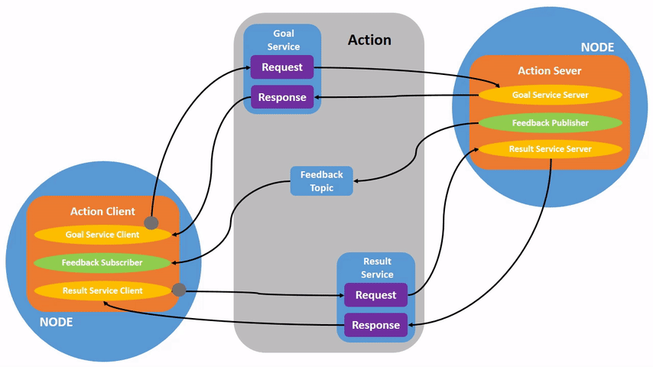
17
ROS2 Action

Slide 18
18
ROS2 CLI tools
Rqt tools

Slide 19
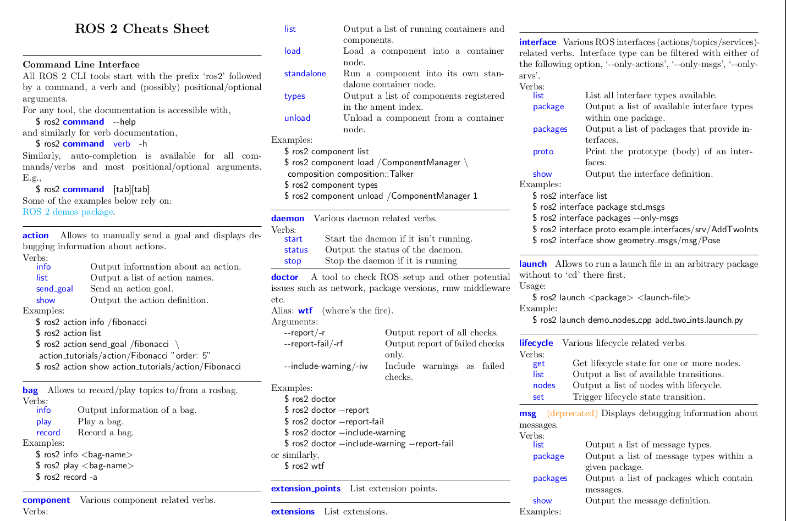
19
ROS2 CLI tools

Slide 20
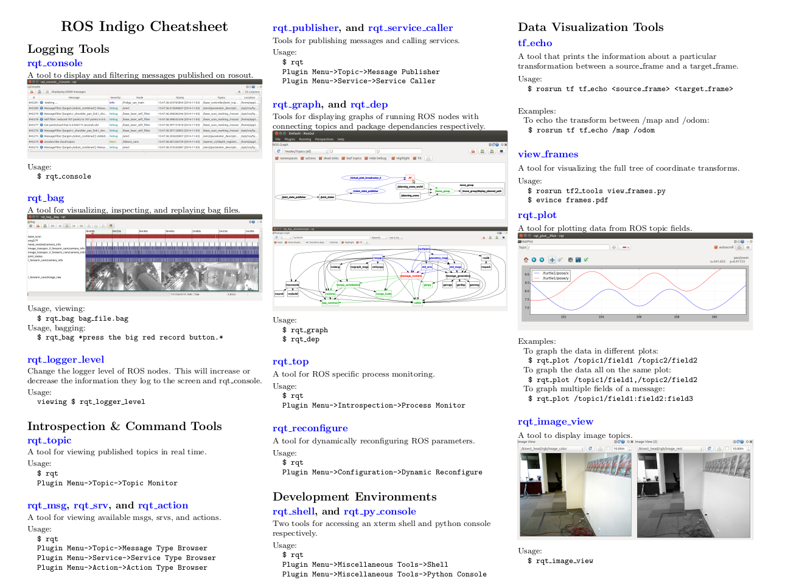
20
Rqt tools

Slide 21
21
ROS2 Tutorials Architecture

Slide 22
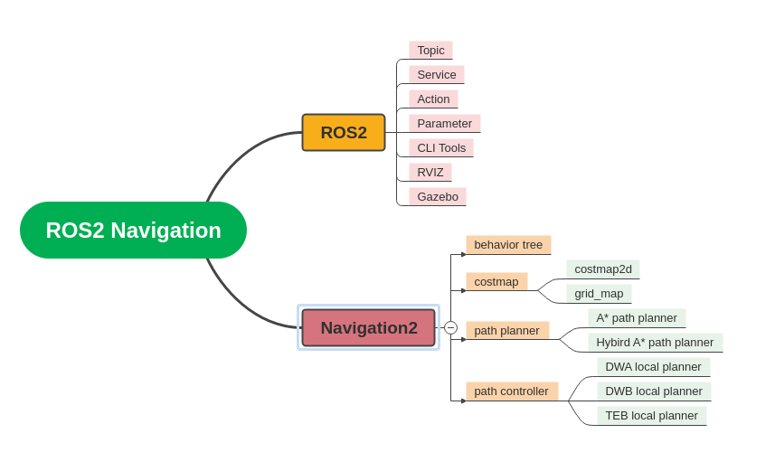
22
ROS2 Tutorials Architecture

Slide 23
23
Summary

Slide 24
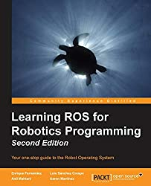
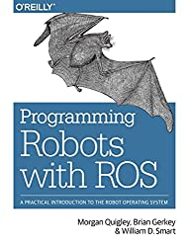
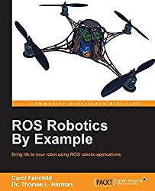
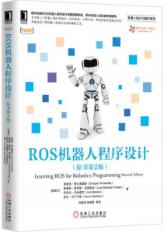
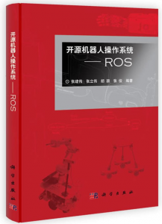
24
Summary
Reference Books
推荐网站
https://docs.ros.org/en/rolling/index.html
http://wiki.ros.org/Books
https://github.com/duyongquan/ros2_tutorials

